Slide 1
Call Center Assignment
Princee Chimnani

Slide 2
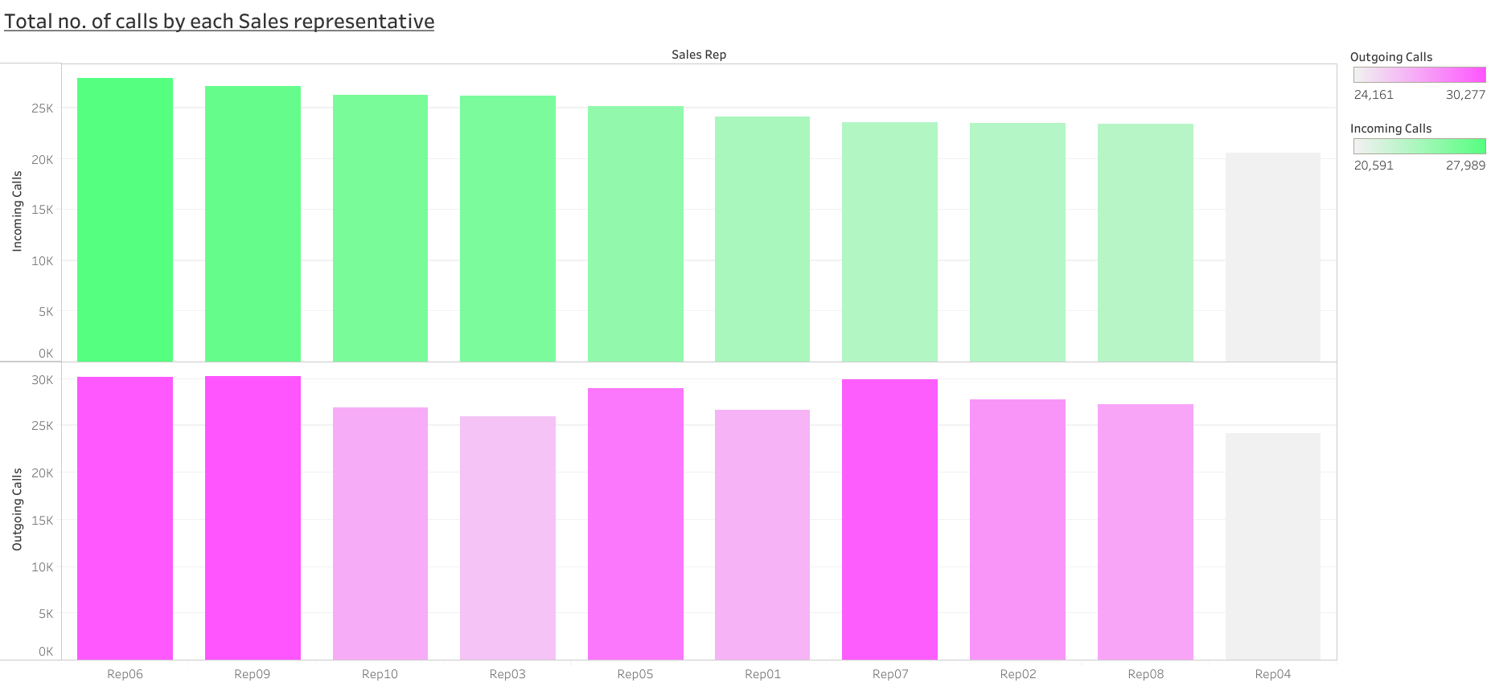

Slide 3
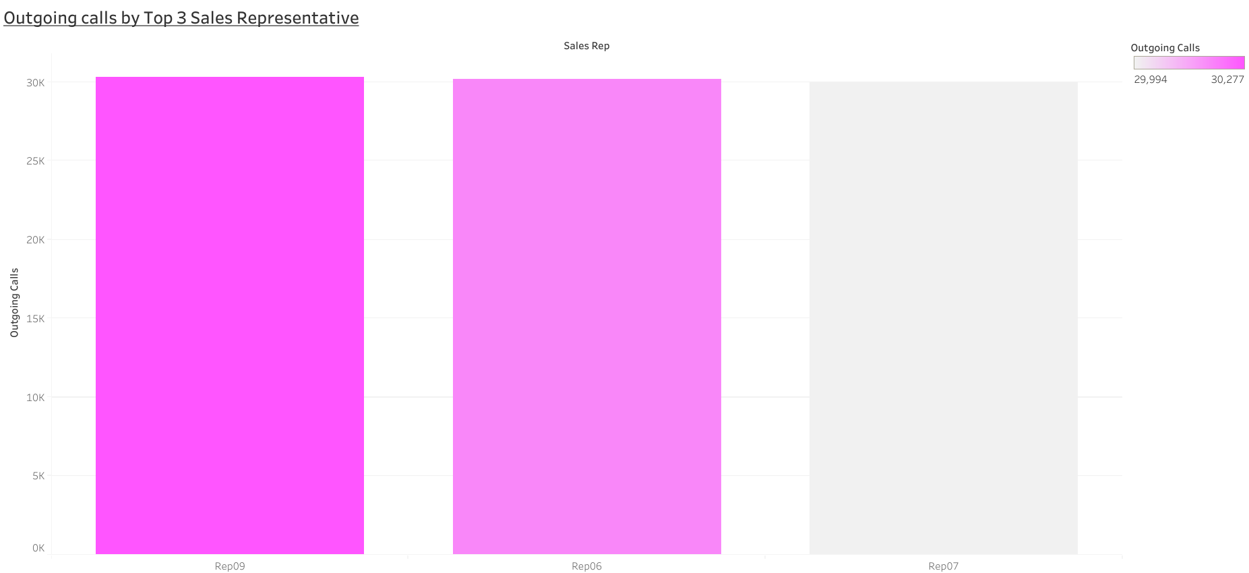

Slide 4
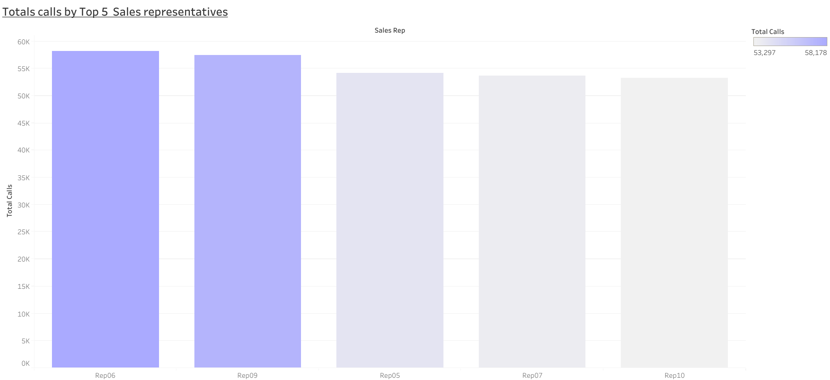

Slide 5
